Slide 1
4. Managerial Decision Making and Problem Solving

Slide 2
Decision and Decision Making
Problem
The unfavourable difference between the actual state of affairs and desired state of affairs.
Decision
Choice made from available alternatives as a solution for a problem.
Decision Making
The act of choosing an alternative from a set of alternatives.

Slide 3
Types of Decisions
Programmed Decisions
A decision that is fairly structured solution to routine problems determined by rules, procedures and habits.
Non-programmed Decisions
Specific solutions created through unstructured process to deal with non- routine problems.

Slide 4
Decision Types & Managerial Levels
Non-Programmed
Decisions
Top
Middle
Programmed
Decisions
Lower

Slide 5
Decision Making Conditions
Certainty
All of the information the decision maker needs is fully available.
Risk
A decision has clear goals and good information is available, but the future outcomes associated with each alternative are subject to chance.
Uncertainty
Managers know which goals they wish to achieve, but information about alternatives and future events is incomplete and managers may have to come up with creative approaches to alternatives.

Slide 6
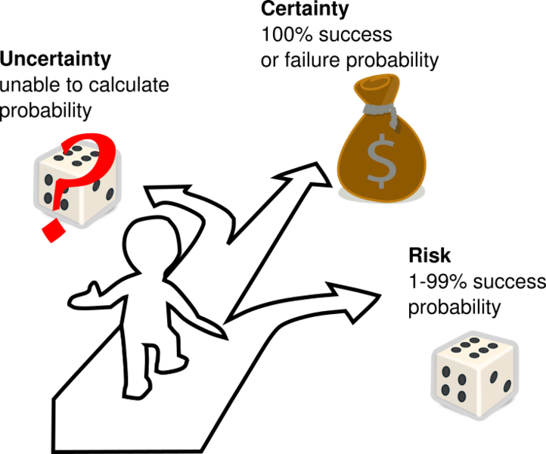
Decision Making Conditions …

Slide 7
Decision Making Conditions and Decisions
Organisational Problems
Low
Possibility of Failure
Certainty
Uncertainty
High
Risk
Programmed
Decisions
Non-programmed
Decisions
Solutions for the problems

Slide 8
Information for Decision Making
Information plays a vital role in making effective decisions.
Characteristics of good information:
Accuracy
Relevancy
Perfection
Timeliness
Cost-effectiveness

Slide 9
Different Types of Information Systems
Level of Systems | Types of Systems
Operational Level Systems Monitor the elementary activities and transactions of an organisation. | Transactions Processing systems (TPS)
Knowledge Level Systems Support knowledge and data workers in an organisation. | Office systems (OS) Knowledge Work Systems (KWS)
Management Level Systems Support the monitoring, controlling, decision making and administrative activities of middle managers. | Decision Support Systems (DSS) Management Information Systems (MIS)
Strategic Level Systems Support the long-term planning activities of senior management. | Executive Support Systems (ESS)
(Laudon and Laudon,2004)

Slide 10
Decision Making Models
Selecting a decision making model depends on :
The manager’s personal preference.
Whether the decision is programmed or non-programmed.
The extent to which the decision is characterized by certainty, risk and uncertainty .

Slide 11
Decision Making Models
Classical Model
The classical model of decision making is based on rational economics assumptions and managerial beliefs about what ideal decision making should be.
Decision maker strives for condition of certainty – gathers complete information, decision maker is rational, criteria for evaluating alternatives are known and use logic.

Slide 12
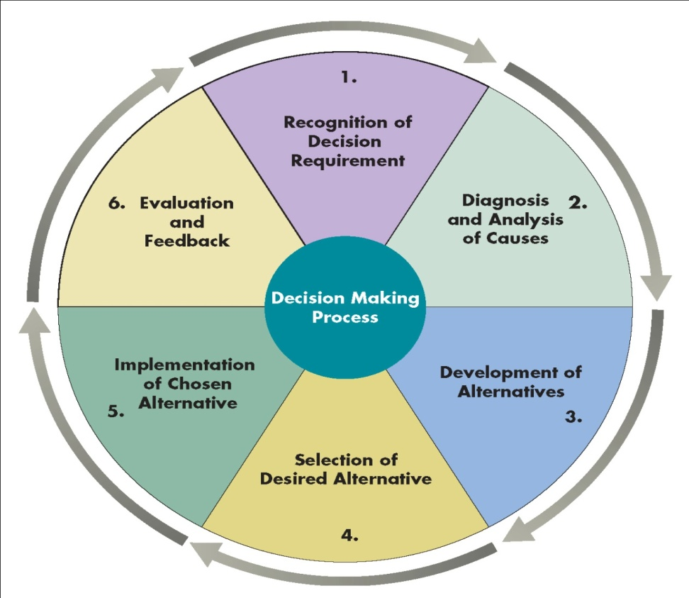
Decision Making Process
(Daft,2012)

Slide 13
Decision Making Models
Administrative Model
How managers actually make decisions in situations characterized by non-programmed decisions, risk and uncertainity.
Two concepts are instrumental in shaping the administrative model.
Bounded Rationality: People have limits or boundaries on how rational they can be. These limitations can be Informational, Computation, Psychological and Cognitive limitations.
Satisficing: Decision makers choose the first solution alternative that satisfies minimal decision criteria.

